Slide 1


ABC Call Volume Trend Analysis
Presentation By, Pranav Jadhav
vedio link
excel link
jupyter notebook

Slide 2

Table of Content
SR. No | Content
1 | Project Description
2 | Tech stack used
3 | Approach
4 | Analysis
5 | Conclusion

Slide 3

Project Description
In this project, we will be diving into the world of Customer Experience (CX) analytics, specifically focusing on the inbound calling team of a company. Inbound customer support, which is the focus of this project, involves handling incoming calls from existing or prospective customers. The goal is to attract, engage, and delight customers, turning them into loyal advocates for the business. We will be using our analytical skills to understand the trends in the call volume of the CX team and derive valuable insights from it.

Slide 4



Tech Stack Used
Microsoft Excel 2016
Jupyter notebook
canva

Slide 5

Approach
For this project I have used Microsoft Excel 2016, Jupyter Notebook with python and python libraries essential for data analysis and Manipulations.
The approach to this project involves Python to clean, manipulate and analyze the dataset. Coding knowledge and Algorithms were applied to handle missing data, handling outliers, create new columns, alter data based on specific criteria.
Microsoft Excel 2016 to generate visualization to draw a meaningful insights through it.

Slide 6
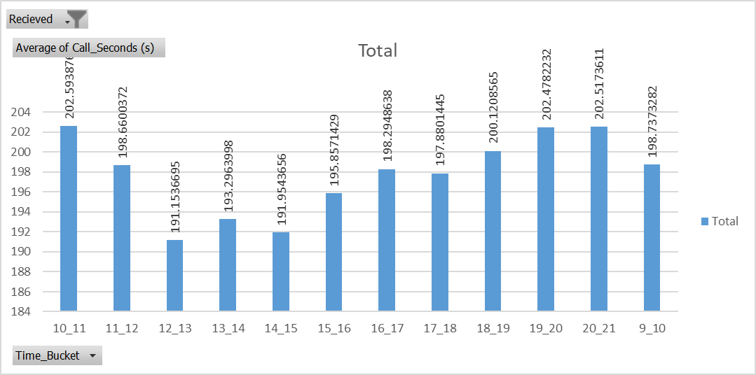

What is the average duration of calls for each time bucket?
Telephone calls
The overall average duration of the calls is 196.96
The peak is seen in the morning between 9am - 12pm, latter it goes low till 4pm and then again rise till 9pm.
Social media
Mobile apps

Slide 7
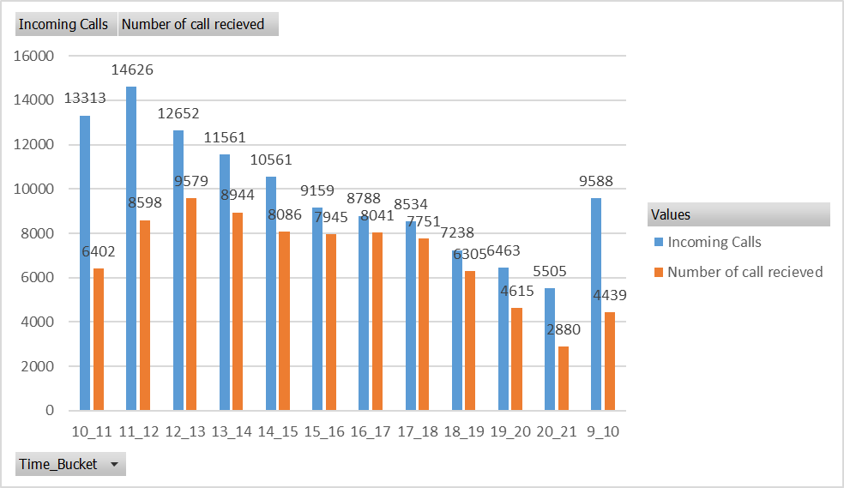
Can you create a chart or graph that shows the number of calls received in each time bucket?
Telephone calls
Social media
we can see the lots of call with respect to the incoming calls were abandoned in the morning, but as day progresses the abandoned calls are reduced.
So as the number of incoming calls as well.
Chatbots
Mobile apps

Slide 8
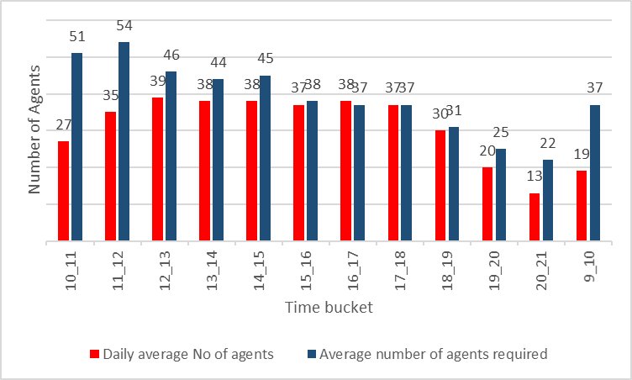
What is the minimum number of agents required in each time bucket to reduce the abandon rate to 10%?
Keeping the average duration of call attended by agent as constant we can get the minimum number of agents required.
We need agents in time bucket of 9am-2pm and then from 6pm - 9pm
For remaining time bucket we have a enough count of agents to recieve the calls so as we can reduce the abondon rate to 10 %.
Social media
Mobile apps

Slide 9
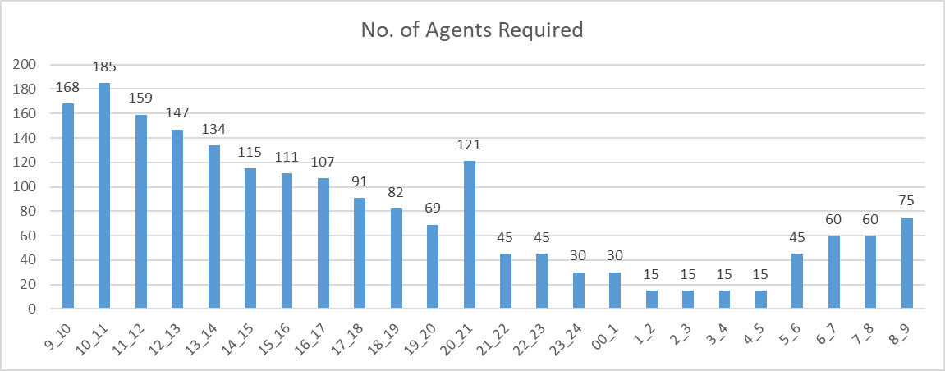
Propose a manpower plan for each time bucket throughout the day, keeping the maximum abandon rate at 10%.
Keeping the average call duration as 196.96 seconds and the time spent on the call by agent is 60% of 7.5 hrs we can come up with the plan of having agents higher count of agents from morning 9am then gradually reducing till 8pm.
Then there is a peak in call during time bucket of 8pm-9pm so the count of agents increased and then droped drastically till 5am in morning. then increasing till 9am.
Chatbots

Slide 10

Conclusions
This project, helped me in understanding the importance of Data Analytics in Customer Experience Analysis as it provides valuable insights which helps in making Data-Driven Decisions.
In this project I was able to get insights like call abandon rates, distribution of call duration, number of calls, agents, how to create a manpower plan so as to decrease abandon calls etc. I also got experience in Data Preprocessing like Data Cleaning, handling Outliers, Feature Engineering etc

Slide 11

Thank You
For Your Attention

